Slide 1
UIPath Project
By James Harper

Slide 2
Project Scope
User registration
Content Aggregation
Report Collation
Detailed Process Description
Information Gathering
Version Control
Outside Resources

Slide 3
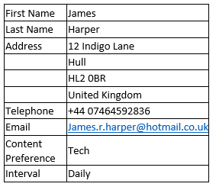
User Registration
Subject Tag Line
Unique ID
Parsing HTML Table
Moving Email

Slide 4
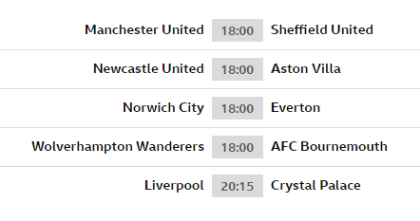
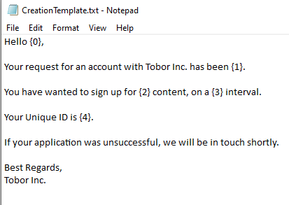
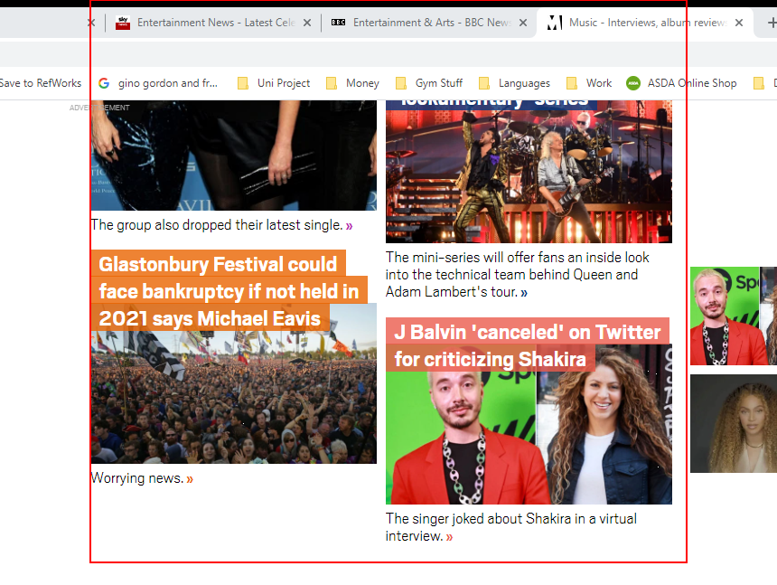
Content Aggregation
Tabular Data
Guaranteed Different Data
Formatting
Issues

Slide 5
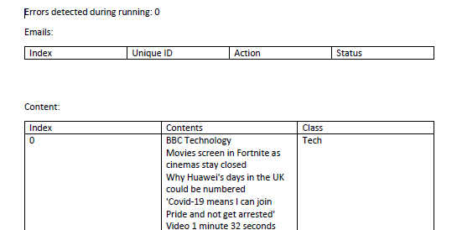
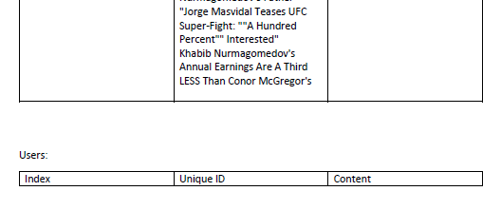
Report Collation
Time Saved
Easy To Read
User Tracking
Error Upkeep

Slide 6
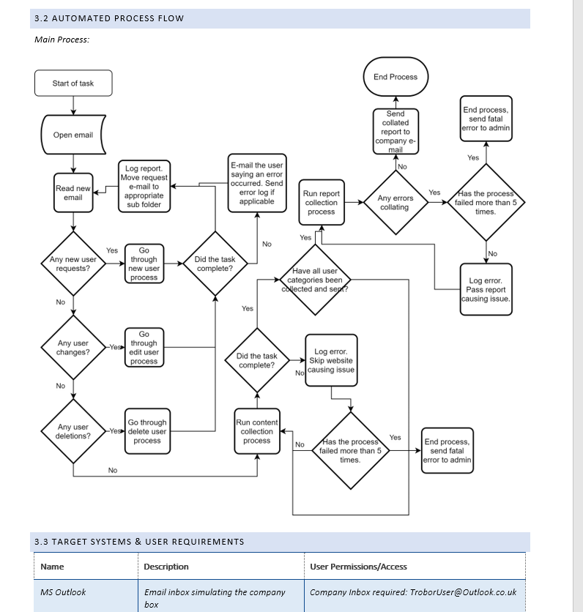
Detailed Process Description (DPD)
Overarching Document
Automation Details
Automation Usage
Pre/Post Automation

Slide 7
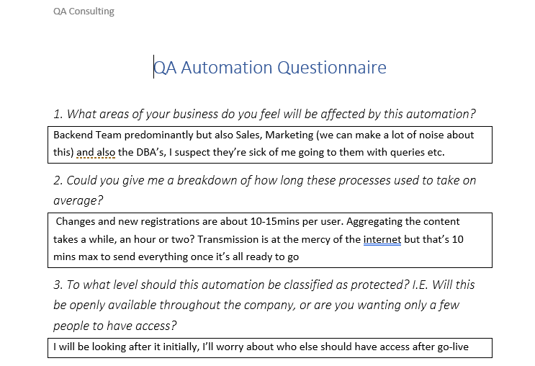
Information Gathering
Project Specification
Specifics
Lost In Translation
Form Of Communication

Slide 8
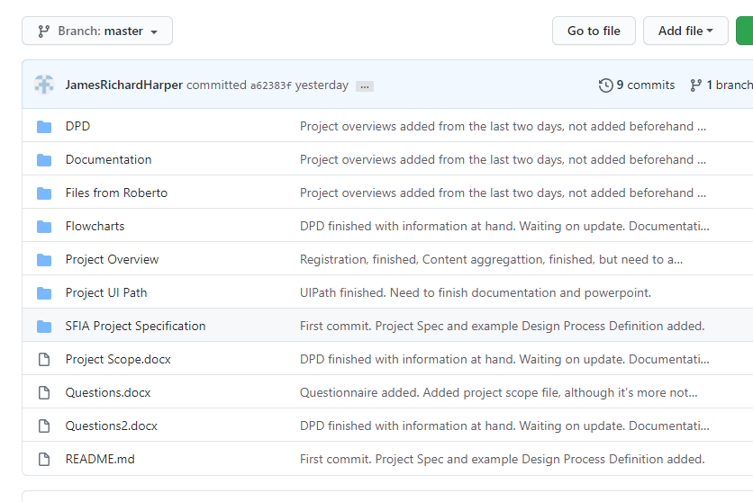
Version Control
File Backups
Testing Software
Company Wide Deployment

Slide 9
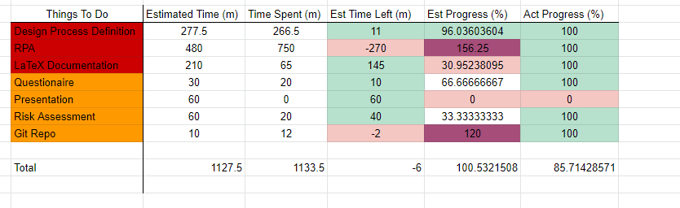
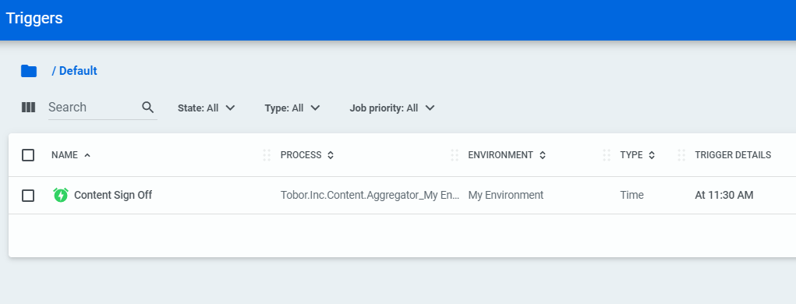
Outside Resources
Management
Where You’re At
Error Keeping
Daily Automating
Security

Slide 10
Improvements
Orchestrator Logs
Orchestrator Credentials
Modular Project
Full Testing Capacity
Time Estimations
Exception Handling

Slide 11
Thanks For Listening!
Is There Any Questions?

